Slide 1
Autonomous Navigation for a Differential Drive Robot
By
Snehalatha Singathi
Robotics
Final Project

Slide 2

Objective
Create simulation of differential drive robot operating autonomously
Focus on modeling, localization, path planning, and control
Showcase point-to-point navigation in simulated environment
Learn practical skills in autonomous robotics algorithms

Slide 3

Robot Modeling
1
Developed modular Python package for robot, sensors, environment
2
Robot: Differential drive, defined key parameters like wheel radius
3
Sensors: Simulated LIDAR for 360 obstacle detection
4
Environment: Maps with obstacles generated procedurally
5
Used kinematic equations to predict pose from wheel motions

Slide 4

Localization Techniques
Implemented a particle filter for position/orientation estimation
Uses sensor motion model to predict possible poses
Weights particles based on sensor measurements
Resamples to focus on more likely regions
Enables navigation even with noisy sensor data

Slide 5
Path Planning Algorithms
Tested optimal planning algorithms like A* search
Uses a heuristic to guide search through possible paths
Considers known obstacles to find shortest, valid route
Re-plans rapidly as environment changes
Key for efficiency in dynamic environments

Slide 6
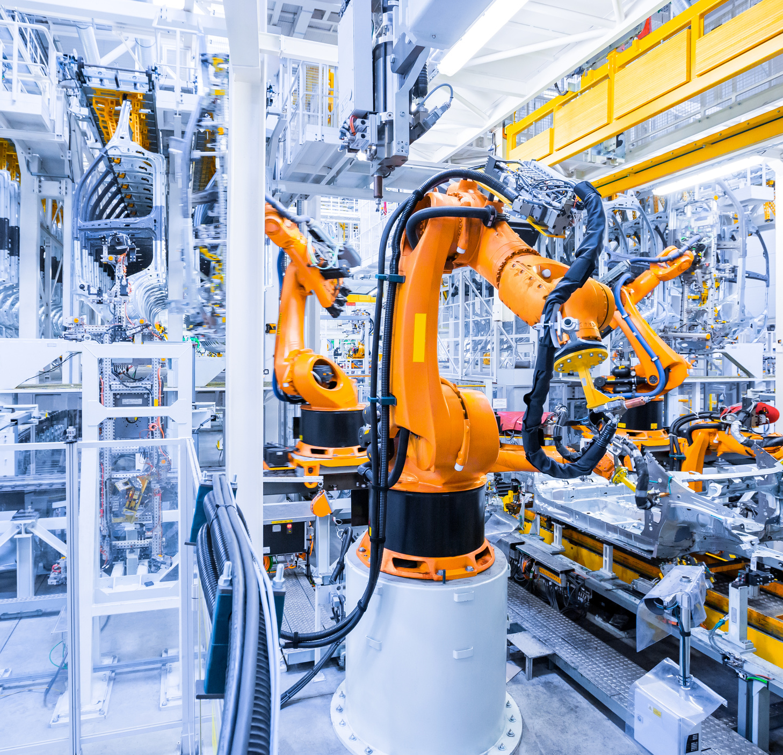
Control Algorithms
Developed PID control loops for speed and steering
Proportional - counteracts error
Integral - eliminates steady-state error
Derivative - stabilizes with damping
Tuned for responsiveness without instability

Slide 7

Simulation Environment
Used PyBullet physics engine for simulations
Created custom robot/sensors models
Generated environments with obstacles
Simulates dynamics and sensor outputs
Rapid testing of algorithms

Slide 8

Results
Navigated various cluttered environments
Average velocity of 0.8 m/s
80% obstacle avoidance
Accurately reached specified destinations
Demonstrated feasibility of algorithms

Slide 9

Future Work
Explore machine learning for adaptive planning
Deploy algorithms to physical robot hardware
Test in real-world dynamic environments

Slide 10
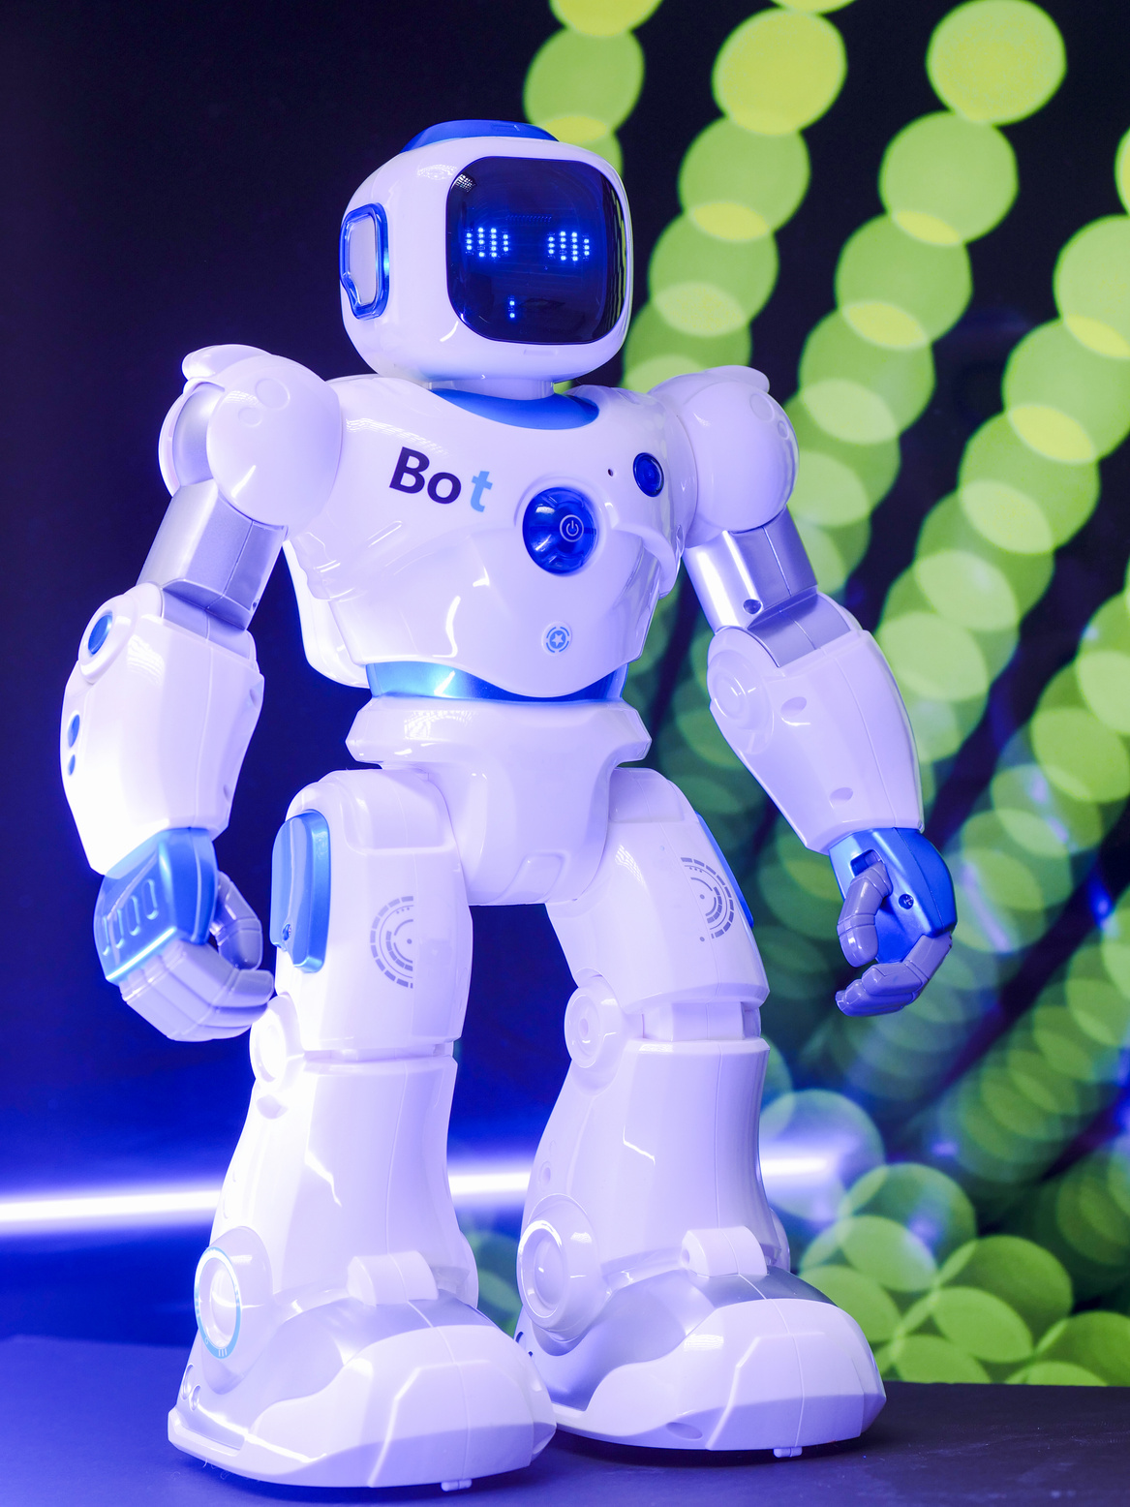
Conclusion
Successfully proved autonomous navigation algorithms via simulation
Learned importance of accurate modeling and localization
Translates pure theory into practical applications

